Slide 1

Power point presentation on Bank Management System

Slide 2
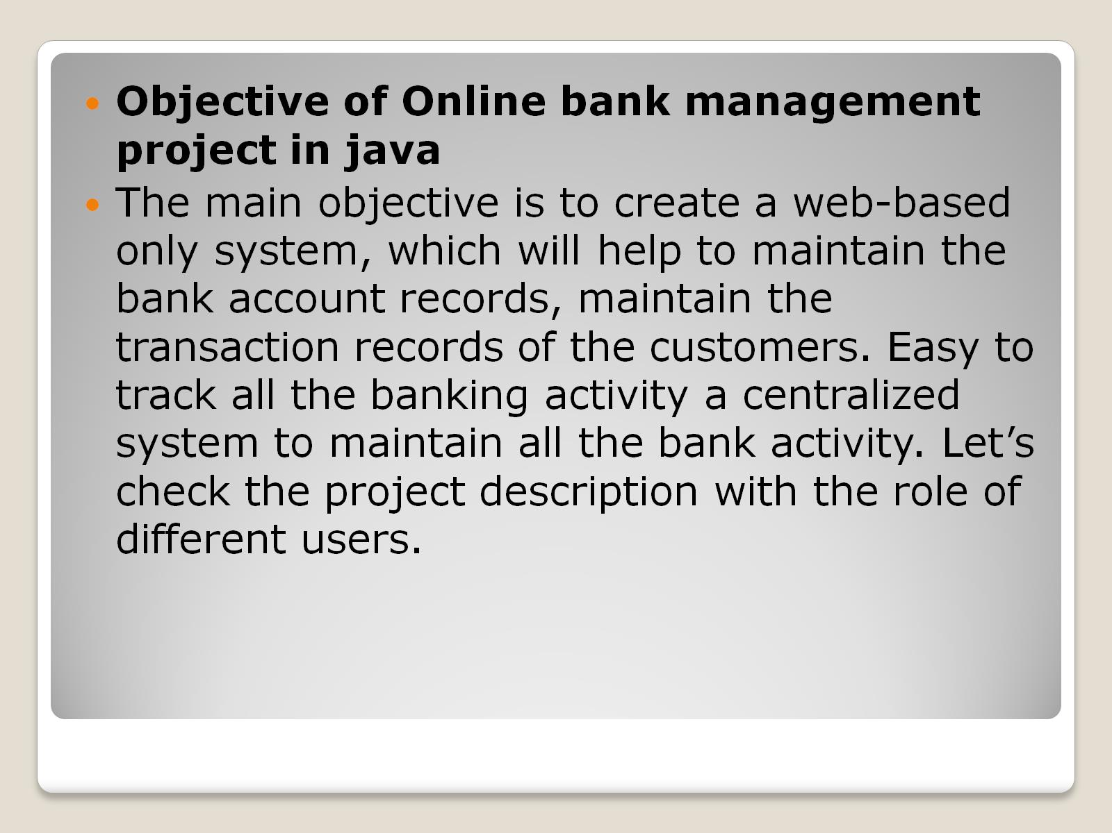

Slide 3
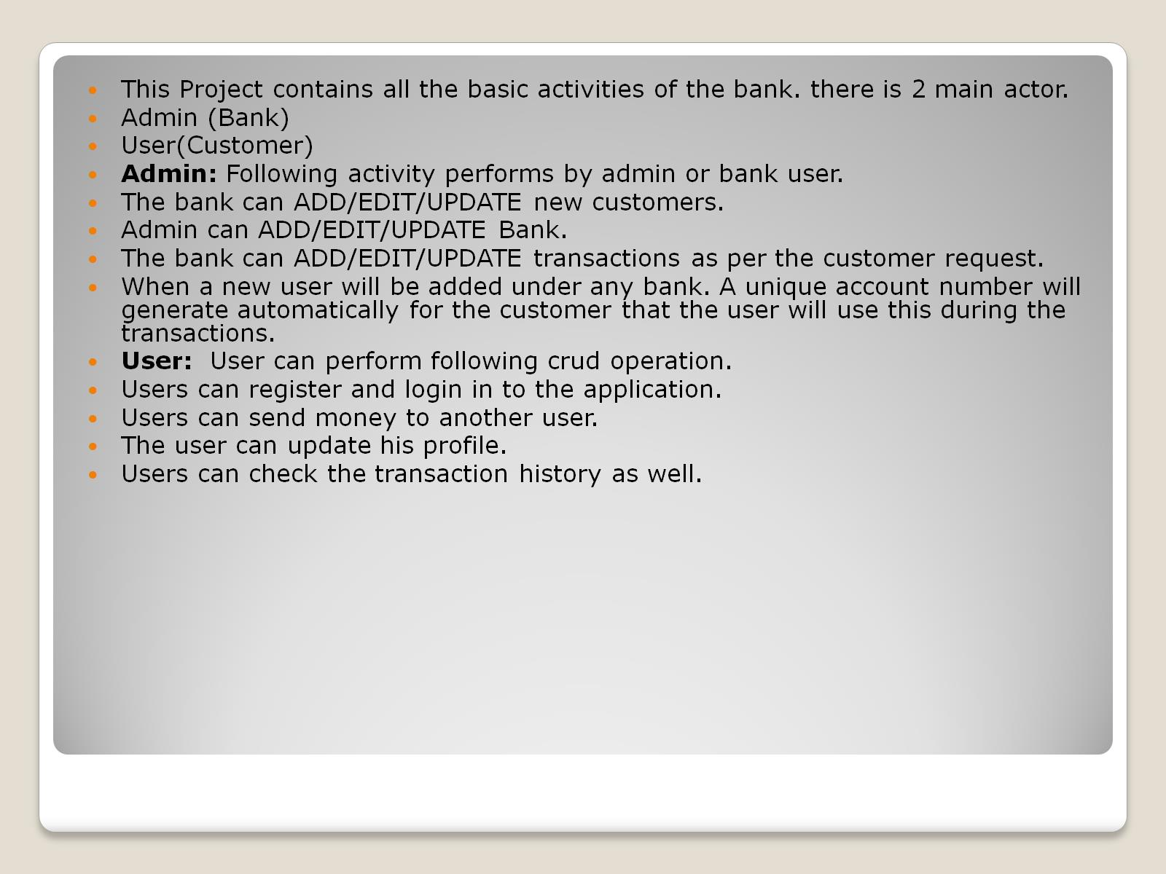

Slide 4
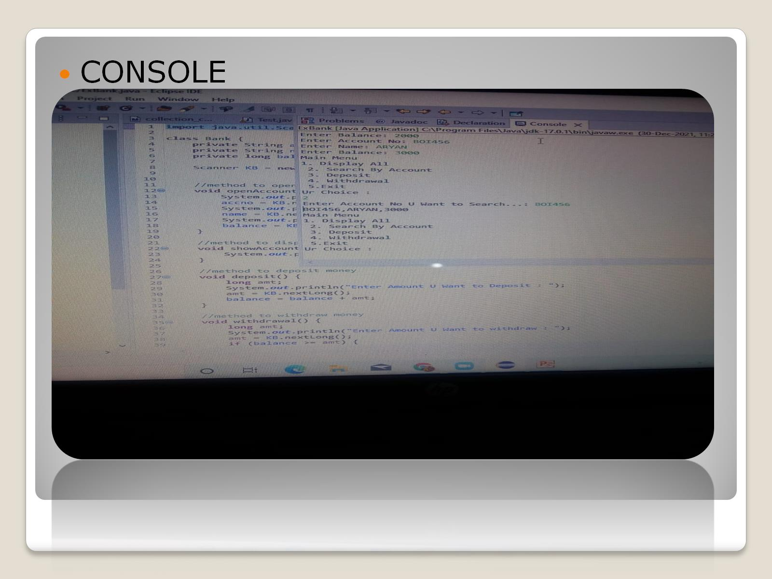

Slide 5

THANKYOU

